Slide 1

YEAR
PRESENTER
2023-24
Shrey Patel
Harsh Dhakecha
Khushdeep Kaur Chilotra
Dharm Joshi
Krushil Dhameliya
Task
Manager
Manage your task with us !!
PROJECT
https://github.com/Dhakechaharsh1/COMP2068JSFrameworks

Slide 2
01
02
Agenda
Introduction
Home Page Overview
Installation Guide
Login Page Overview
Tasks Page Overview
Add Task Page Overview
Contact Page Overview
About Page Overview
Conclusion
NEXT

Slide 3
The Task Manager application simplifies task management for individuals and teams. It offers features like task creation, priority management, deadline tracking, and team collaboration. The application's mission is to improve productivity and provide a user-friendly platform. It includes pages for login, home, tasks, add task, contact, and about.
INTRODUCTION
Project Summary
NEXT

Slide 4
Installation Guide
This slide provides a step-by-step guide on how to install the Task Manager application from the terminal.
1
2
3
Creating an express scaffolded project using npx express-generator command.
Install the necessary dependencies using npm.
Run the application using the 'npm start' command.
NEXT

Slide 5

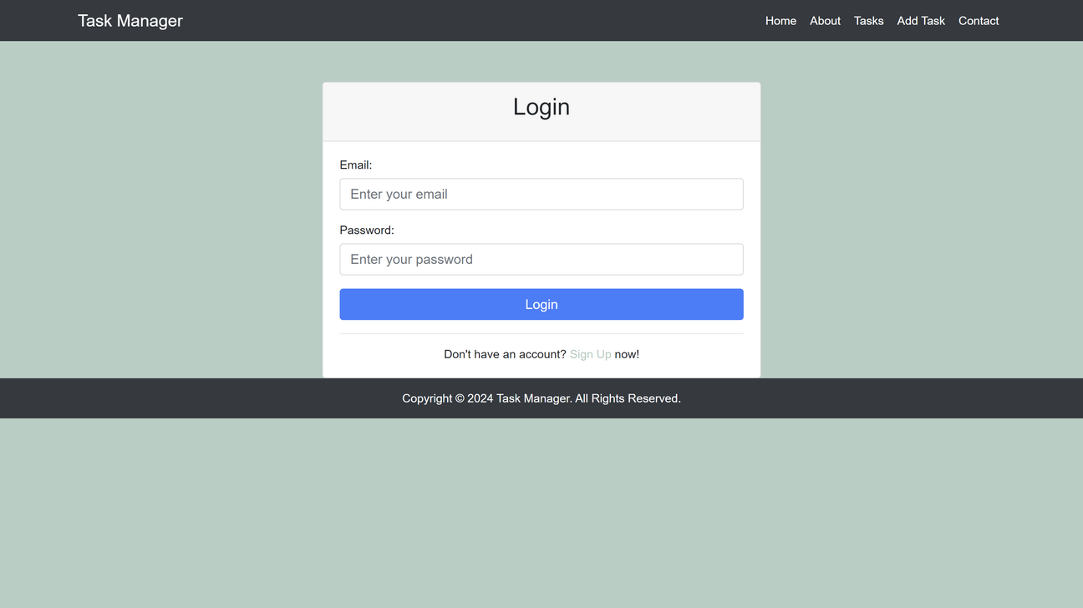
Login Page Overview
DESCRIPTION:
THE LOGIN PAGE LETS USERS LOG IN TO THEIR TASK MANAGER ACCOUNT SECURELY.
FEATURES :
USERNAME AND PASSWORD VALIDATION.
SECURE AUTHENTICATION PROCESS.
REDIRECTS TO THE HOME PAGE UPON SUCCESSFUL LOGIN.

Slide 6

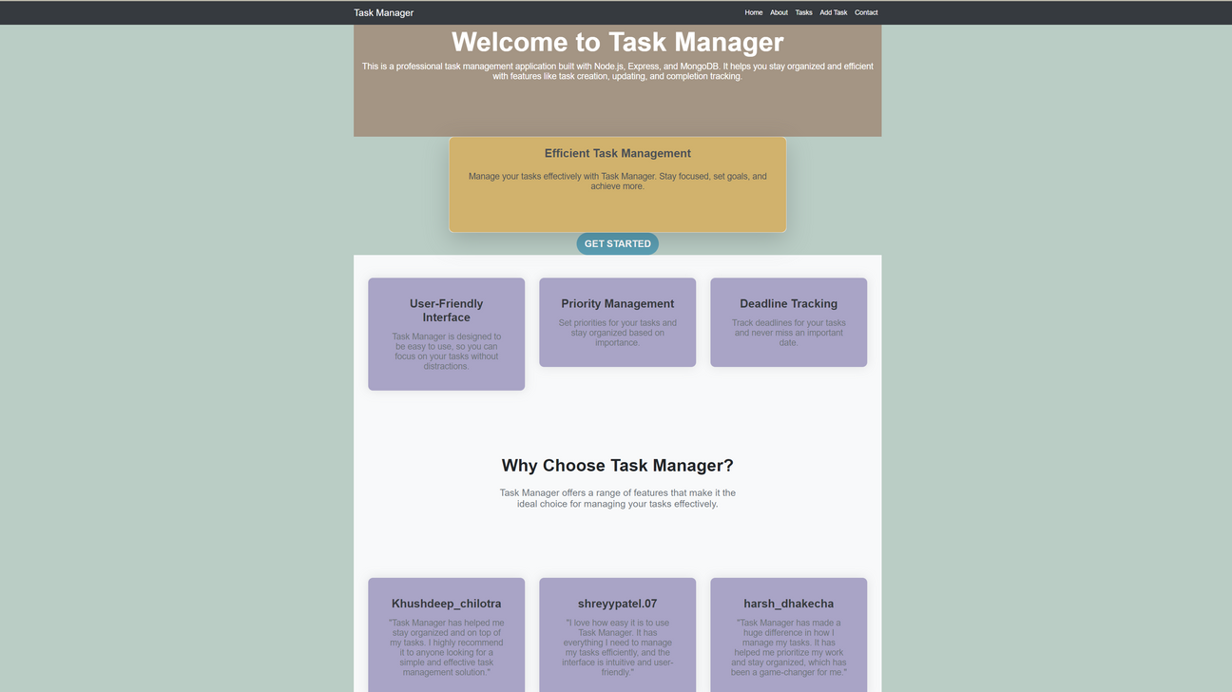
Home Page Overview
DESCRIPTION:
THE HOME PAGE PROVIDES AN OVERVIEW OF THE TASK MANAGER APPLICATION AND ITS FEATURES.
FEATURES:
WELCOME MESSAGE AND INTRODUCTION.
LINKS TO DIFFERENT SECTIONS OF THE APPLICATION.
SUMMARY OF TASKS OR OTHER RELEVANT INFORMATION.
NEXT

Slide 7
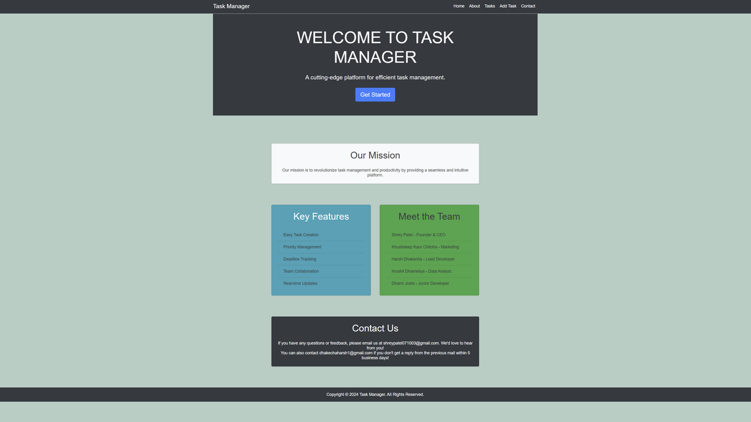
About Page Overview
Description:
The about page provides information about the Task Manager application and its development team.
Features:
Details about the application's mission and goals.
Information about the development team members.
Links to social media or other resources.
NEXT

Slide 8

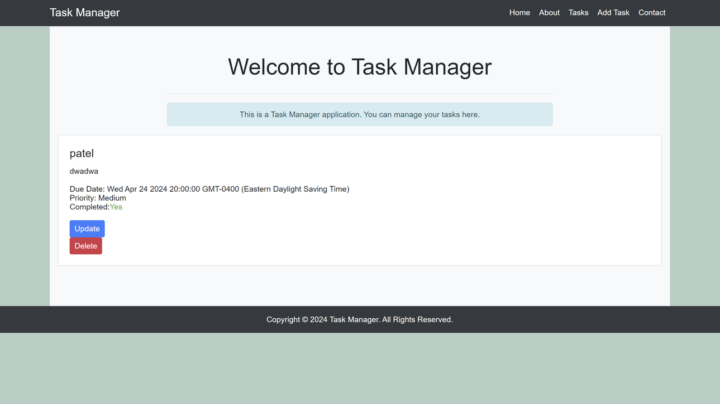
Tasks Page Overview
DESCRIPTION:
ThE TASKS PAGE DISPLAYS A LIST OF TASKS AND ALLOWS USERS TO MANAGE THEM EFFICIENTLY.
FEATURES:
LIST OF TASKS WITH DETAILS SUCH AS TITLE, DESCRIPTION, DUE DATE, AND PRIORITY.
ABILITY TO TOGGLE THE COMPLETION STATUS OF TASKS.
OPTIONS TO UPDATE OR DELETE TASKS.
NEXT

Slide 9

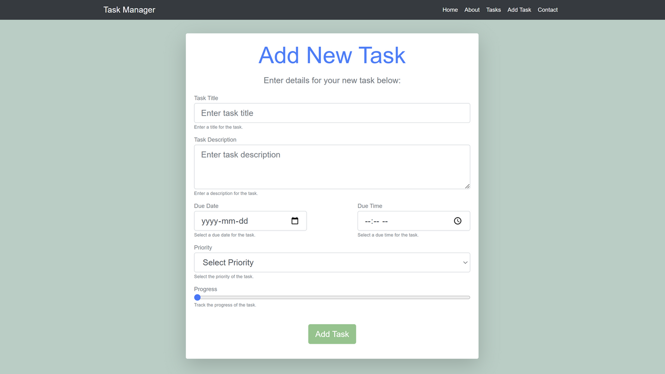
Add Task Page Overview
Description:
The add task page allows users to add new tasks to the Task Manager application.
Features:
Form for adding a new task with fields for title, description, due date, and priority.
Validation of input fields before submission.
Submission of tasks to the server for storage.
NEXT

Slide 10
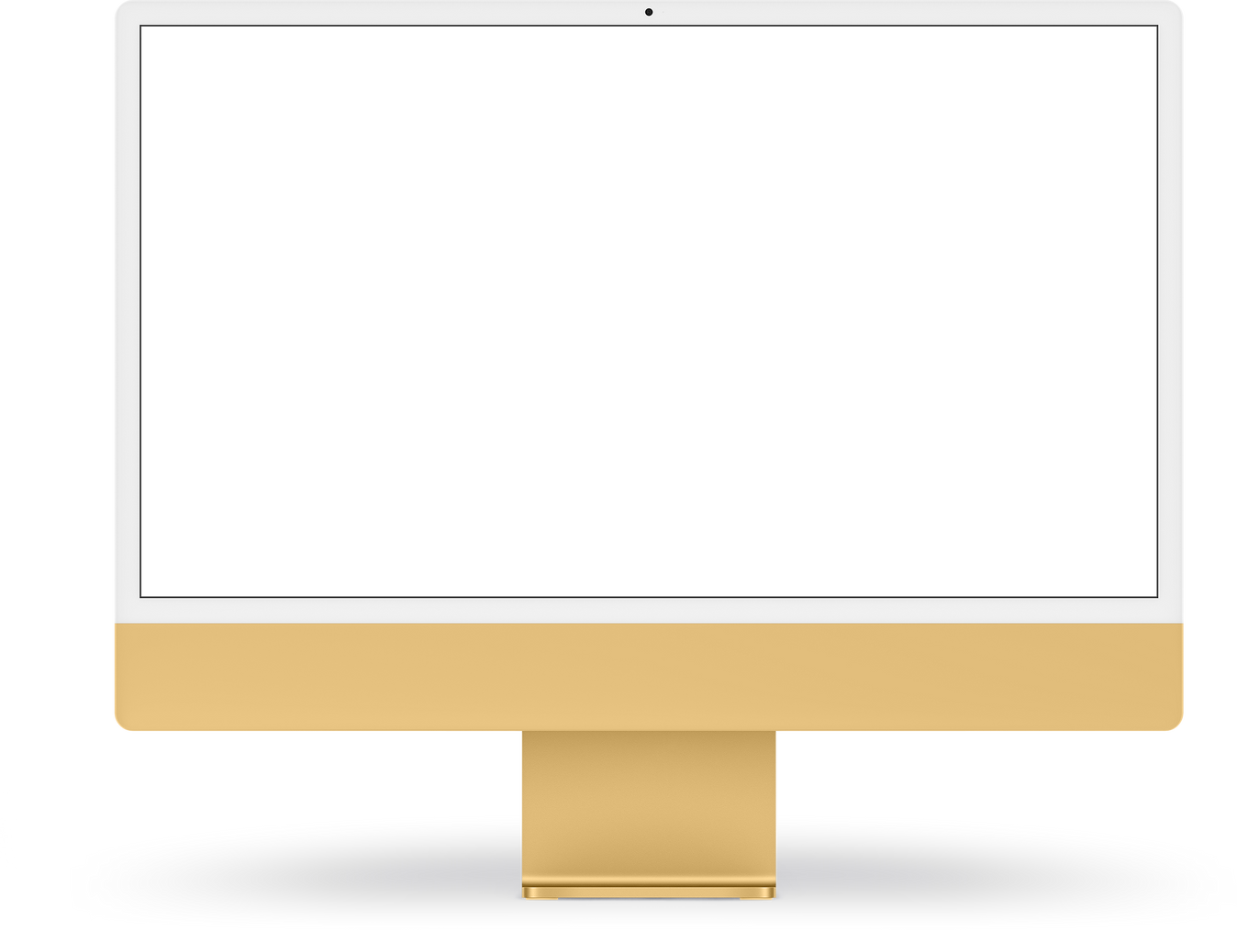
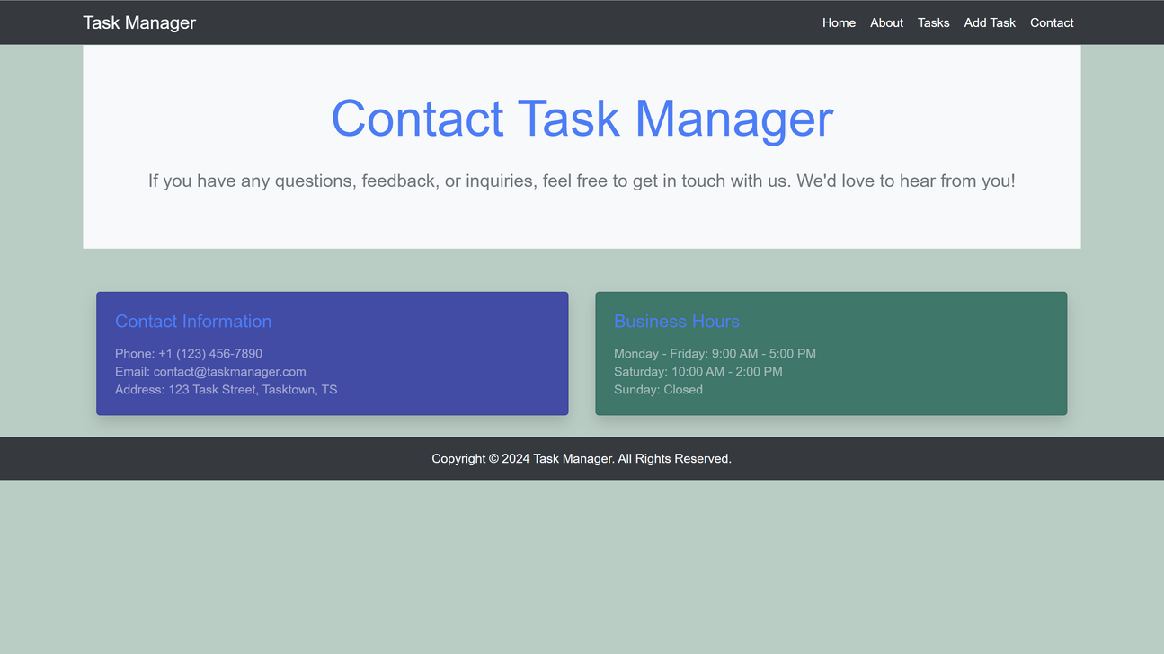
Contact Page Overview
DESCRIPTION:
THE CONTACT PAGE PROVIDES A WAY FOR USERS TO SUBMIT FEEDBACK OR CONTACT THE SUPPORT TEAM.
FEATURES:
FORM FOR SUBMITTING NAME, EMAIL, AND MESSAGE.
CLIENT-SIDE VALIDATION OF THE FORM.
SUBMISSION OF MESSAGES TO THE SERVER FOR PROCESSING.
NEXT

Slide 11
CONCLUSION
Thank you for viewing our presentation on the Task Manager application. We hope you found it informative and helpful.

